Slide 1

Data Analytics
tdc
the-data-condas
The Best Place to Work.

Slide 2

Where are the best opportunities for Data Analytics?
We want to help Bootcamp graduates understand the current US job market.
In order to set career paths.
To make informed decisions.
x
x

Slide 3

Hypothesis:
tdc
San Francisco is the best place to work for Data Analysts.

Slide 4
How do we define “Best”?
We want to help Bootcamp graduates understand the current US job market.
Highest pay.
Lowest cost of living.
Most open jobs relevant to our skills.
Most open jobs with great employee reviews.

Slide 5
Our Research
tdc
Sources
Name | Type | URL | Purpose
themuse.com job board | API | Row text | Row text
Glassdoor.com | csv | Row text | Row text
Cost of Living
Article top company | Row text | Row text | Row text
Article most desirable | 123.45 | 123.45 | 123.45

Slide 6
Collecting Data and Cleaning Data
tdc
x
API
.CSV
x
x
x
x
x
x

Slide 7

Data Analysis:

Slide 8
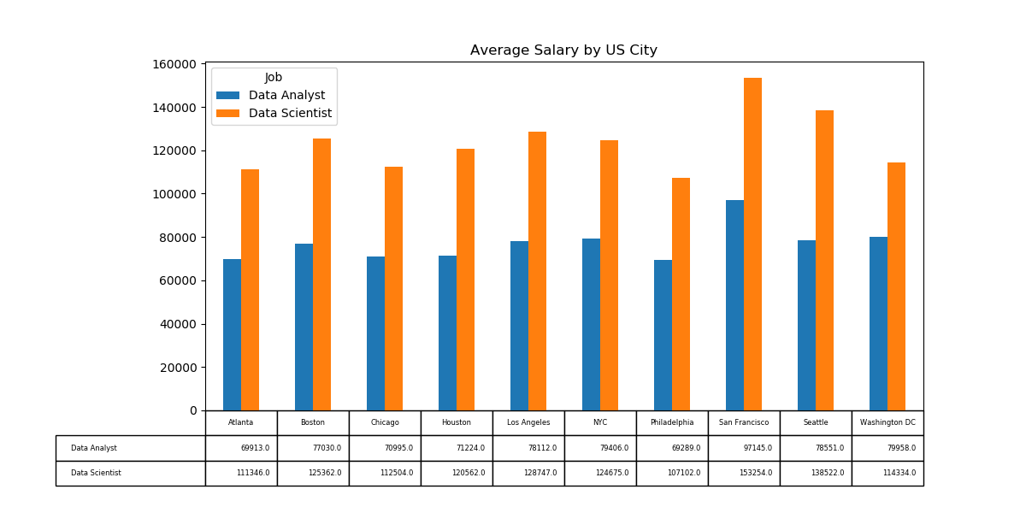
Which US city has highest salary?
tdc
Based on Average Salary for Top 10 US cities.

Slide 9
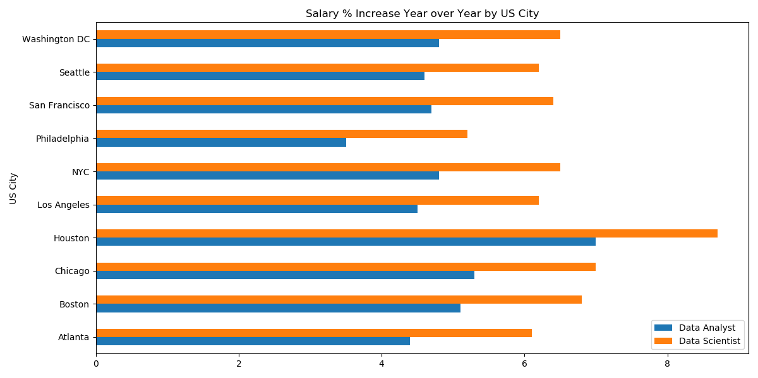
Which US city has highest salary increase over the last 12 months?
tdc
Based on Average Salary for Top 10 US cities.

Slide 10
Which US city has the lowest cost of living?
tdc
Mean based salary for top 10 US cities.
findings

Slide 11
How many job openings does each city have for Data Analytics?
tdc
Sorted by entry, mid and senior levels.
findings

Slide 12
How many job openings does each city have for Data Science?
tdc
Sorted by entry, mid and senior levels.
findings

Slide 13
Top Companies to work
tdc
Employee recommended companies based on Glassdoor.com survey as of 05/06/2020.

Slide 14
Top Companies to work for vs. most openings
tdc
Based on…
findings

Slide 15
Question 4
tdc
x
findings

Slide 16
Challenges and Limitations
tdc
x
Up-to-date free API
.CSV
x
x
x
x
x
x

Slide 17
Conclusion
tdc
x
findings

Slide 18

Section Divider
tdc
the-data-condas
Subtitle

